Slide 1


<Theo>
<Feb 21 2025>

Slide 2

Outline
Executive Summary
Introduction
Methodology
Results
Conclusion

Slide 3
Executive Summary
SpaceX, a leading American company in space exploration and rocket technology, has revolutionized the industry with cost-effective launches at $62 million—significantly lower than the $165 million charged by competitors. As a data scientist at the emerging aerospace company SpaceY, I am conducting research to assess the feasibility of surpassing SpaceX in this competitive landscape.

Slide 4
Introduction
Since 1957, nations have competed to push the boundaries of space exploration, from satellite launches to deep-space missions. However, the cost of these endeavors remains a significant challenge, with the average rocket launch requiring approximately $165 million. SpaceX has revolutionized the industry by dramatically reducing launch costs to just $60 million, leveraging cutting-edge technology and innovations in rocket reusability.
A defining breakthrough for SpaceX is its ability to land and reuse the first stage of its rockets, a key factor in making space travel more affordable and sustainable. This achievement has reshaped the modern space race, enabling more frequent missions and expanding possibilities for interplanetary exploration.
In this research, we aim to identify the critical factors influencing successful rocket landings. By analyzing variables such as launch location, payload mass, orbital trajectory, and mission conditions, we will apply data science methodologies—utilizing IBM’s advanced tools—to gain deeper insights into SpaceX’s success. Through rigorous data analysis and visualization, we will uncover the key drivers behind efficient rocket recovery and their implications for the future of space exploration.

Slide 5

Section 1

Slide 6
Methodology
Executive Summary
Data collection methodology:
Data is collected using SpaceX rest API and the use of web scraping of data.
Perform data wrangling
We use a series of python libraries such as Pandas and Numpy to pre-process data. The removal of unnecessary columns and normalization and standardization of data are a few techniques we will use.
Perform exploratory data analysis (EDA) using visualization and SQL
Perform interactive visual analytics using Folium and Plotly Dash
Perform predictive analysis using classification models
We will begin by splitting the data into training and test sets, identify the optimal algorithm and parameters through Grid Search, and then deploy the best-performing model using the selected algorithm with optimized parameters.

Slide 7
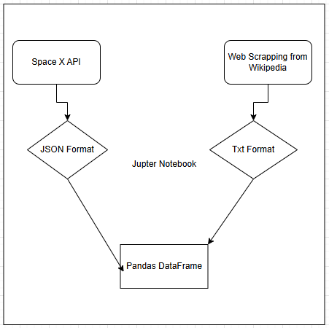
Data Collection
Describe how data sets were collected.
We used two main sources for the collection of information.
SpaceX API: An open-source REST API used to access data on launches, rockets, capsules, Starlink satellites, launchpads, and landing pads.
Wikipedia: A free online encyclopedia, collaboratively created and edited by volunteers worldwide, and hosted by the Wikimedia Foundation.
The process of how data was collected

Slide 8
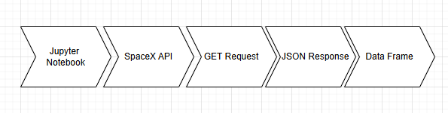
Data Collection – SpaceX API
We began data collection from the SpaceX API by importing essential libraries such as Pandas, NumPy, and Requests. Next, we established a URL GET request, retrieving the data in JSON format. The JSON response was then converted into a DataFrame by extracting key information, including geospatial data, rocket type, orbit, flight number, and more
Please click here to view the completed SpaceX API calls notebook
Place your flowchart of SpaceX API calls here

Slide 9
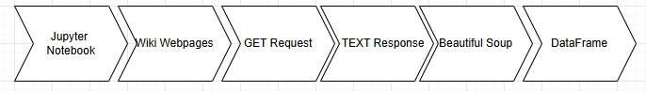
Data Collection - Scraping
As before, we began by importing the necessary Python libraries, BeautifulSoup and Requests, to perform our task. This time, we used a Wikipedia webpage titled ‘SpaceX Falcon 9 First Stage Landing Prediction’ as our data source. We initiated an HTTP GET request, receiving the response in text format. Using BeautifulSoup, we efficiently extracted the relevant tables and columns from the response, which were then converted into a Pandas DataFrame for further analysis
Please click here to view the completed SpaceX web scraping notebook
Place your flowchart of web scraping here

Slide 10
Data Wrangling
At this stage, we began by importing Pandas and NumPy, followed by loading the collected data from the previous stage. Our goal was to conduct exploratory data analysis (EDA) to clean the dataset and identify the most relevant features for training a machine learning model.
Please click here to view the completed data wrangling notebook
Load dataset and libraries
Calculate missing value per attribute as a percentage
Identify which columns are numerical and categorical
Calculate the number of launches on each site
Calculate the number and occurrence of each orbit
Calculate the number and occurrence of mission outcome of the orbits
Create a landing outcome label from Outcome column
Determine the successful landing rate for first stage rockets

Slide 11
EDA with Data Visualization
At this stage we completed the Exploratory Data Analysis process by finding the correlation between various dependents and independents with the aid of various visualization tools. The main libraires used in this section were the seaborn and matplotlib. We also worked on converting types of columns to suit our data
Please click here to view the completed EDA with data visualization notebook.
Visualize the relationship between Flight Number and Launch Site
Visualize the relationship between Payload Mass and Launch Site
Visualize the relationship between success rate of each orbit type
Visualize the relationship between FlightNumber and Orbit type
Visualize the relationship between Payload Mass and Orbit type
Visualize the launch success yearly trend

Slide 12
EDA with SQL
Task Performed
Here we queried the dataset using SQL commands to complete the tasks seen to the right.
Please click here to view the completed EDA with SQL notebook.
Display the names of the unique launch sites in the space mission
Display 5 records where launch sites begin with the string 'CCA'
Display the total payload mass carried by boosters launched by NASA (CRS)
Display average payload mass carried by booster version F9 v1.1
List the date when the first succesful landing outcome in ground pad was acheived
List the names of the boosters which have success in drone ship and have payload mass greater than 4000 but less than 6000
List the total number of successful and failure mission outcomes
List the names of the booster_versions which have carried the maximum payload mass. Use a subquery
List the records which will display the month names, failure landing_outcomes in drone ship ,booster versions, launch_site for the months in year 2015.
Rank the count of landing outcomes (such as Failure (drone ship) or Success (ground pad)) between the date 2010-06-04 and 2017-03-20, in descending order.

Slide 13
Build an Interactive Map with Folium
Geospatial data was used to place markers, circles and lines on a map to identify various launch sites.
TASK 1: Mark all launch sites on a map – we identified 4 locations along with their latitude and longitude
TASK 2: Mark the success/failed launches for each site on the map - placed launches into 2 groups
TASK 3: Calculate the distances between a launch site to its proximities – after calculating the distances we attempted to draw polylines to show distance.
Please click here to view the completed interactive map with Folium map.

Slide 14
Build a Dashboard with Plotly Dash
Add a Launch Site Drop-down option for each Launch Site for ease in selecting 1 or all sites
Attempted to create pie charts that shows the count for successful launches per site.
Add a Range Slider to Select Payload
Attempted to create scatterplots to render the successful launches and and their payload to discern correlation.
Please click here to view the completed Plotly Dash lab.

Slide 15
Predictive Analysis (Classification)
To build the best-performing classification model, we started by importing the necessary libraries and loading the dataset. The data was standardized to eliminate bias and then split into 80% training and 20% testing sets. We initialized four classification algorithms—Logistic Regression (LR), Support Vector Machine (SVM), Decision Tree (DT), and K-Nearest Neighbors (KNN)—and used the Grid Search technique to fine-tune their hyperparameters. To evaluate model performance, we employed key metrics, including the Confusion Matrix for visualization, the F1 Score for balanced accuracy, and the Jaccard Score for similarity measurement. After comparing the performance of all models, the best-performing algorithm was selected for deployment, ensuring optimal classification accuracy.
Please click here to view the completed predictive analysis lab.
Import Libraries and Define Auxiliary Functions
Standardize data ensuring to reassign where fitting
Calculate accuracy on test data
Conduct evaulation methods
Create a NumPy array from a column ensuring the output is a Panda series
Spilt data into a test and training sets 20-80 split
Used the Grid Search Technique
Assess which method performs the best

Slide 16
Results
Exploratory data analysis results
Interactive analytics demo in screenshots
Predictive analysis results

Slide 17

Section 2

Slide 18
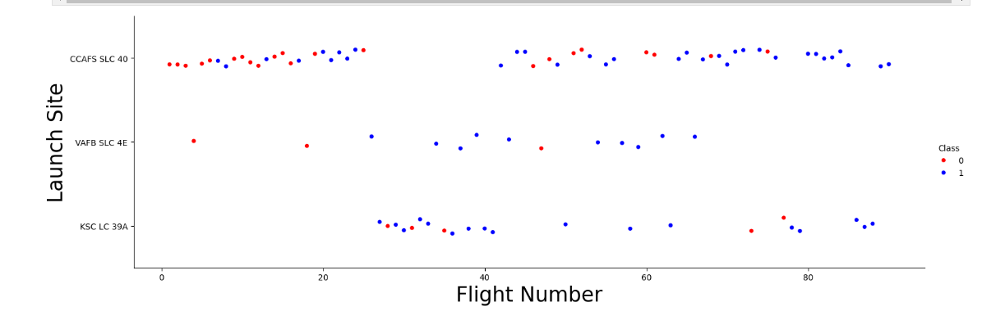
Flight Number vs. Launch Site
From the plot we understood that CCAFS SLC 40 is the most used site for launching rockets, The least can be seen to be VAFB SLC 4E with only 13 launches however it has only 3 failures making it one of the most successful launch rate.

Slide 19
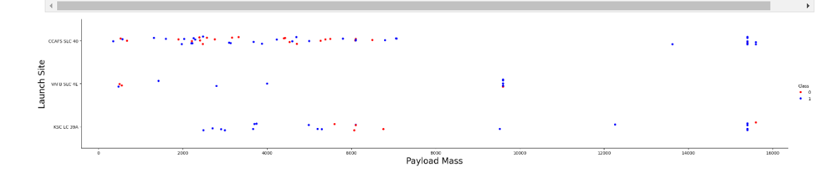
Payload vs. Launch Site
The plot suggest that there is no correlation between the payload size and the launch sites as they both contain similar amounts of failures and successes.

Slide 20
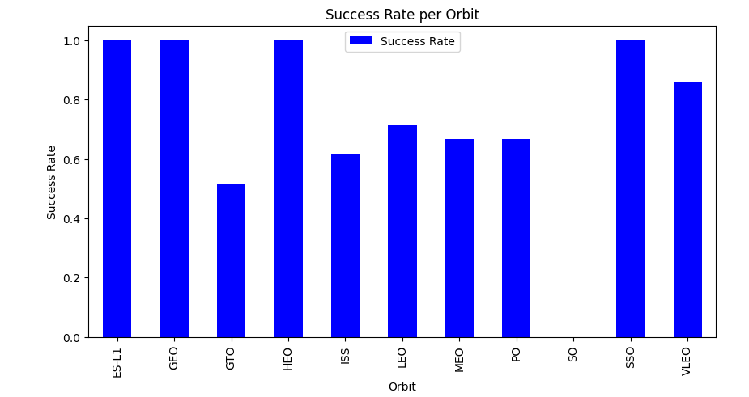
Success Rate vs. Orbit Type
The bar chart allows us at a glance to determine the best orbits for successful returns of the first stage rockets. ES-11, GEO, HEO, and SSO have the joint highest whilst GTO the lowest.

Slide 21
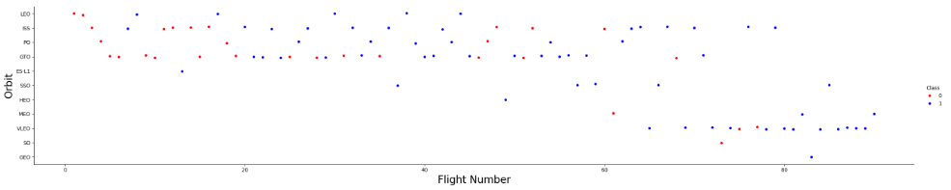
Flight Number vs. Orbit Type
There is a gradual increase in the number of success as there is an increase in flight number, for LEP, ISS and VLEO orbits but GTO doesn’t show this correlation.

Slide 22
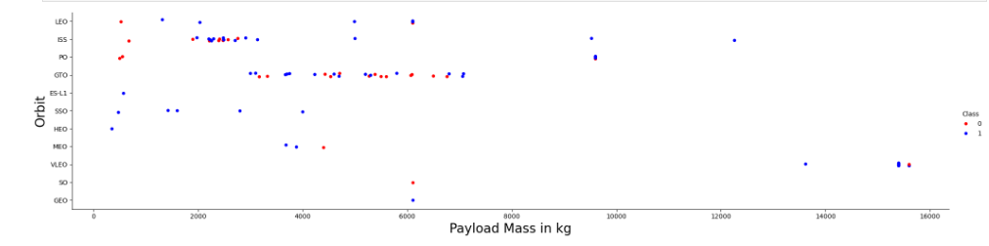
Payload vs. Orbit Type
The red dots show us that lower payload causes unsuccessful landing we see this in LEO and ISS as well as PO orbits. GTO shows the payload has no effect on success.

Slide 23
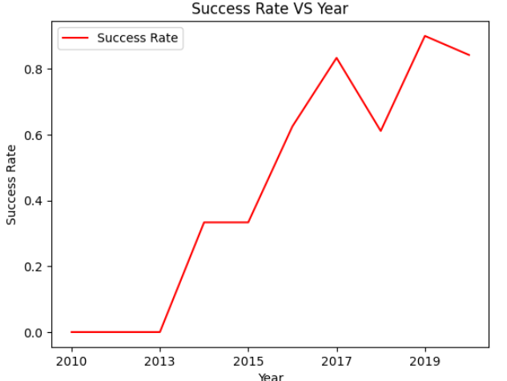
Launch Success Yearly Trend
There is a positive trend seen in the success rate as the time goes by.

Slide 24
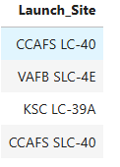
All Launch Site Names
We used SQL queries to identify distinct launch_sites from SPACEXTABL table. This produce 4 results.

Slide 25
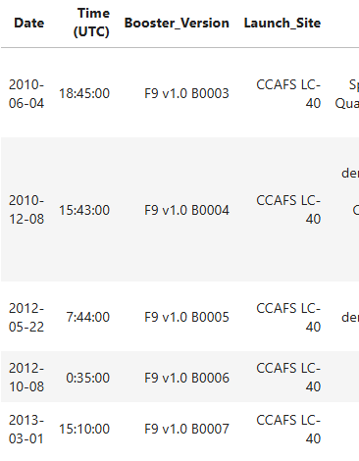
Launch Site Names Begin with 'CCA'
To identify launch sites beginning with ‘CCA’ we queried the table SPACEXTBL for launch_site that started with CCA. To do this we used a wildcard format ‘CCA%’ ensuring that the first 3 letters CCA furthermore, be present at the beginning of the name. Furthermore, the use of LIMIT(5) was used to produce only 5 results.

Slide 26
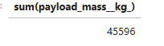
Total Payload Mass
To get he total payload mass we queried the sum of table payload_mass_kg from the spacextabl and ensured that only customers equal to ‘NASA (CRS)’ was produced.

Slide 27
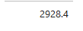
We selected the avg function for the column payload_mass_kg from SPACEXTBL where the booster_version had to equal ‘F9 v1.1’.
Average Payload Mass by F9 v1.1

Slide 28
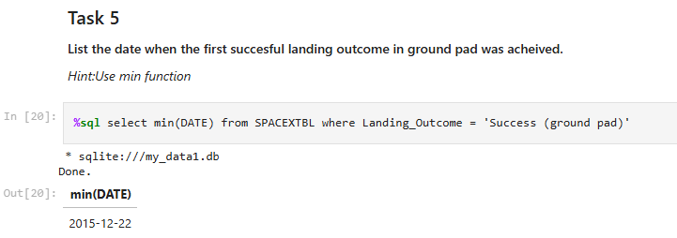
First Successful Ground Landing Date
From my query the first successful ground landing date was the 22nd December 2015

Slide 29
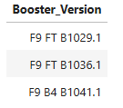
Successful Drone Ship Landing with Payload between 4000 and 6000
To identify the successful drone ship landings, we ensured that the column that contained the names of the boosters (booter_version) was selected from the table SPACEXTBL. We then queried the tables to produce results where landing_outcome was equal to ‘ Success (drone ship)’ and where payload_mass_kg was between 4000 to 6000.

Slide 30
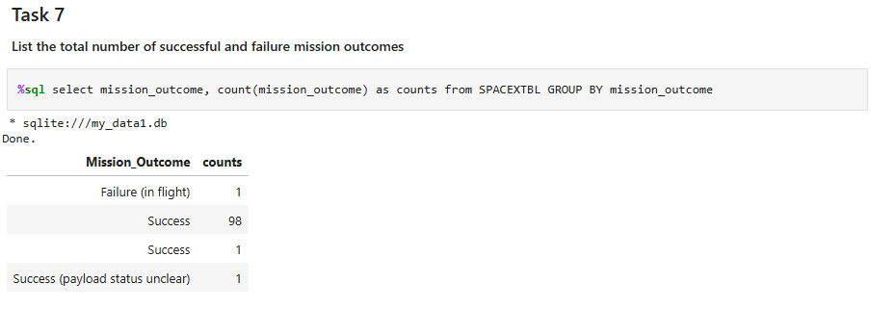
I attributed the difference in Success to be a trimming in the dataset issue, however 99 successful missions occurred in total.
Total Number of Successful and Failure Mission Outcomes

Slide 31
Boosters Carried Maximum Payload
F9 B5 B1048.4
F9 B5 B1049.4
F9 B5 B1051.3
F9 B5 B1056.4
F9 B5 B1048.5
F9 B5 B1051.4
F9 B5 B1049.5
F9 B5 B1060.2
F9 B5 B1058.3
F9 B5 B1051.6
F9 B5 B1060.3
F9 B5 B1049.7
To gather the max payload carried by booster the below was used:
select distinct booster_version from SPACEXTBL where payload_mass__kg_ in (select max(payload_mass__kg_) from SPACEXTBL);

Slide 32
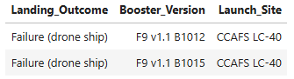
2015 Launch Records
In 2015 2 failed landings were recorded , coincidentally both occurred at the same launch site. Booster 12 and 15 both recorded failures.
select Landing_Outcome, booster_version, launch_site from SPACEXTBL where (Landing_Outcome = 'Failure (drone ship)' and date like '2015%')

Slide 33
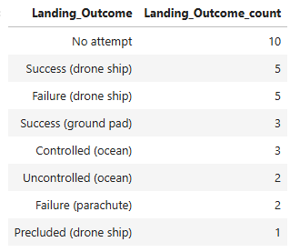
Rank Landing Outcomes Between 2010-06-04 and 2017-03-20
Rank the count of landing outcomes (such as Failure (drone ship) or Success (ground pad)) between the date 2010-06-04 and 2017-03-20, in descending order.
select Landing_Outcome, count(*) as Landing_Outcome_count from SPACEXTBL where DATE between '2010-06-04' and '2017-03-20' group by Landing_Outcome order by count(Landing_Outcome) desc

Slide 34

Section 3

Slide 35
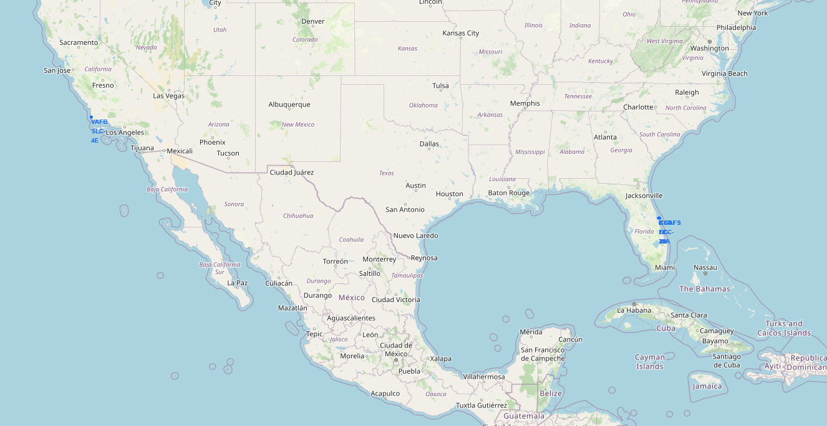
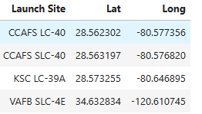
Launch sites Folium Map
Based on my investigation, SpaceX launch sites are strategically located at lower latitudes to take advantage of Earth's rotational velocity. This positioning helps reduce fuel requirements, as rockets launched closer to the Equator gain additional speed from Earth's rotation. Additionally, launch sites are typically situated near coastal locations and over open water to minimize risks to populated areas in case of launch failures. Coastal proximity also enhances booster recovery operations, as first-stage boosters can land on drone ships or safely return to land after launch.

Slide 36
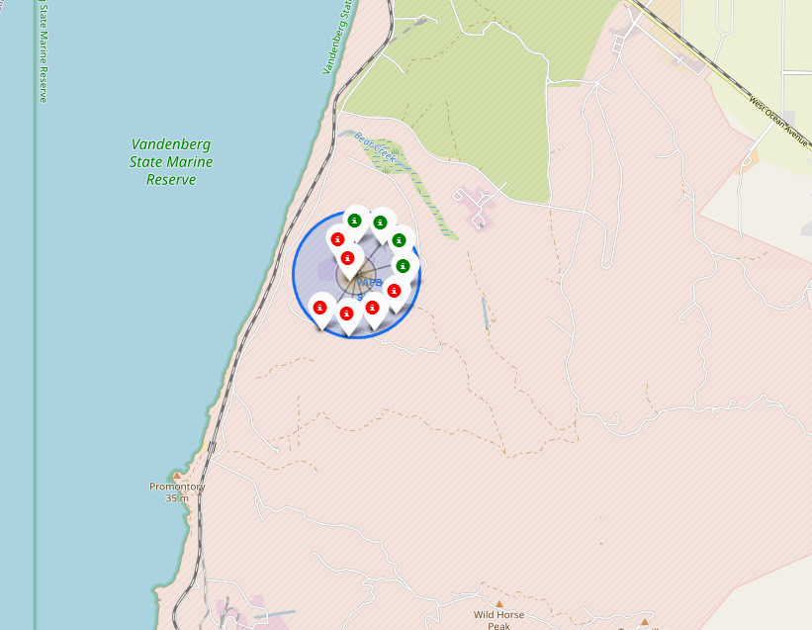
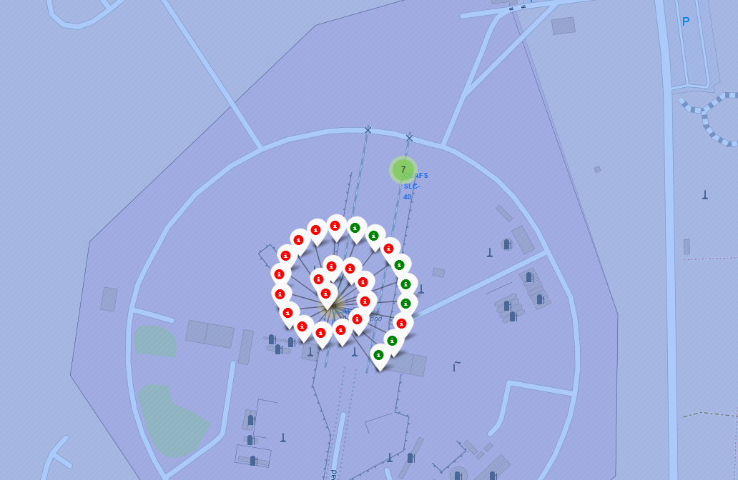
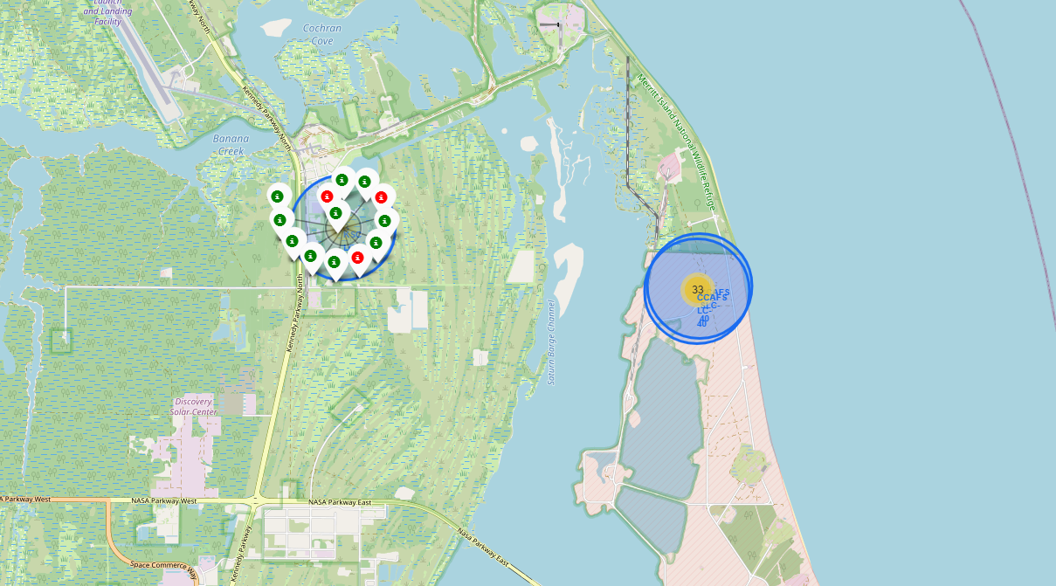
Success Rate per Location
We can see that at the various locations the markers present indicate success rate. With Green being successful and Red a failed return.

Slide 37
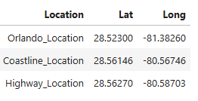
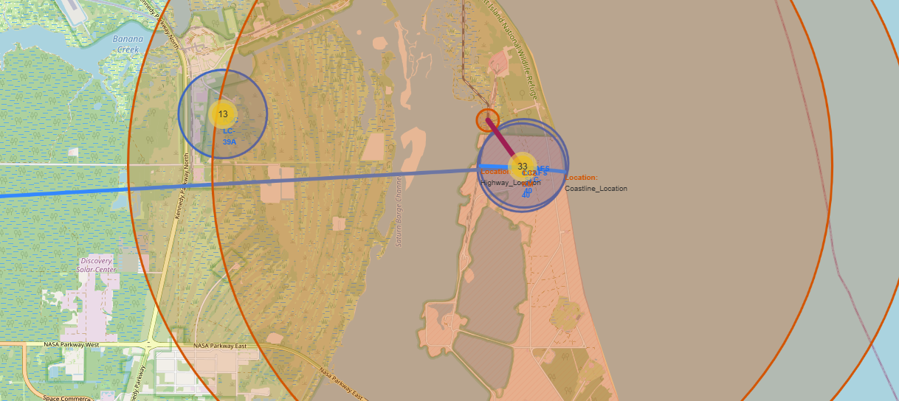
Proximities closest to launch site CCAFS LC-40
The location of CCAFS LC-40 is Lat: 28.5623 and Long: -80.5774as such the calculated distances would be
Orlando_Location: ~79.6 km
Coastline_Location: ~0.9 km
Highway_Location: ~0.9 km

Slide 38

Section 4

Slide 39
Launch Success per Site

Slide 40
KSC LC 39A Dashboard: Total Launch Success

Slide 41
Payload Correlation per Site

Slide 42

Section 5

Slide 43
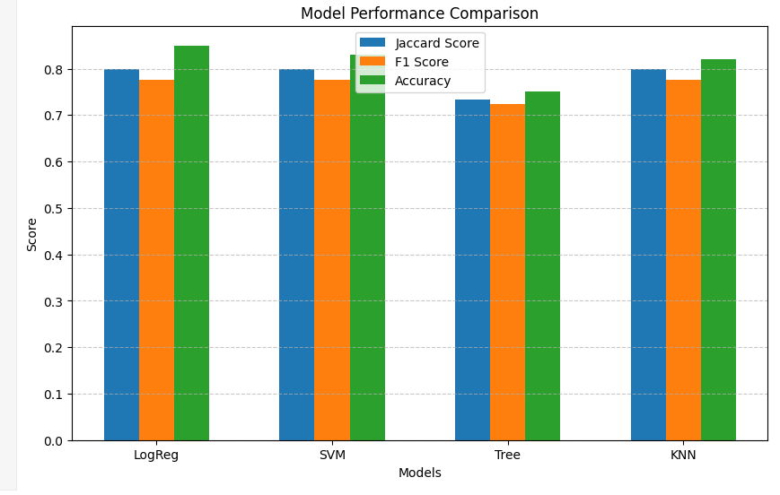
Classification Accuracy
From the graph Decision Tree performed the worst out of all models used

Slide 44
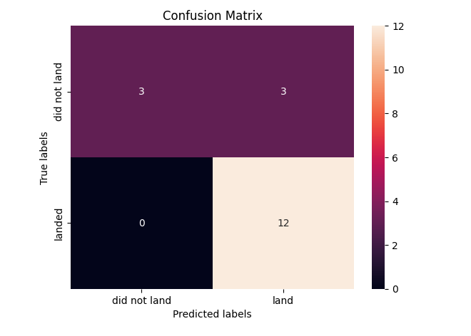
Confusion Matrix
The confusion matrix of the Logistic Regression and the KNN provided similar results

Slide 45
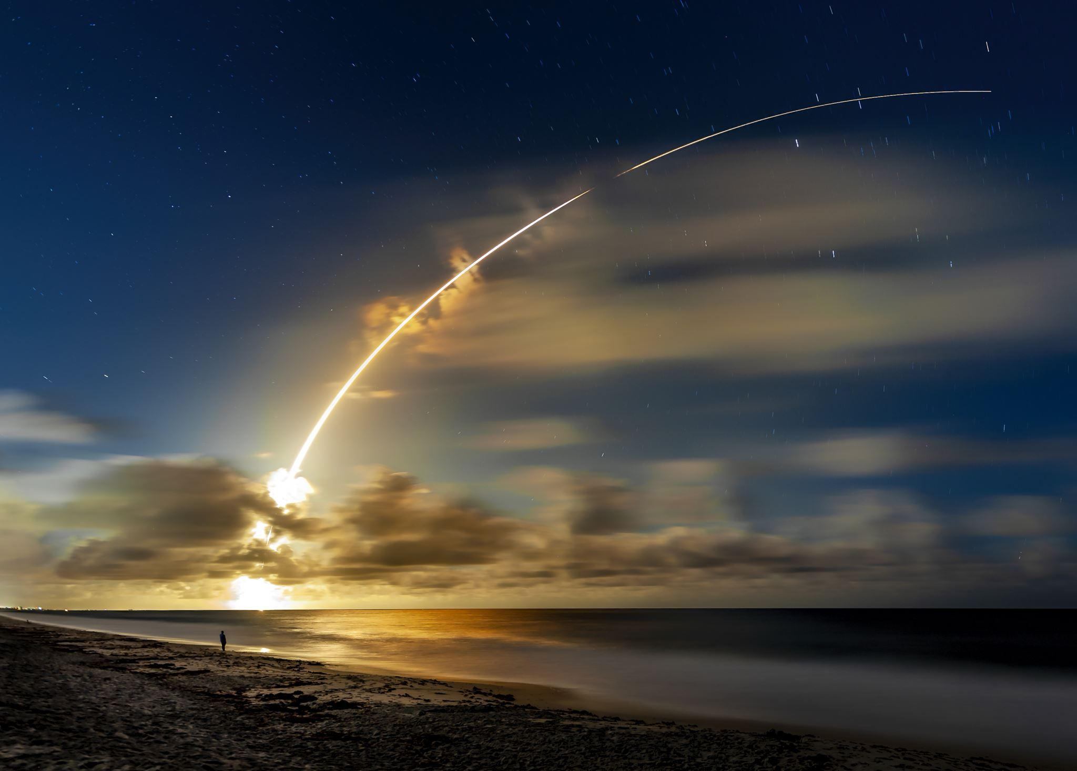
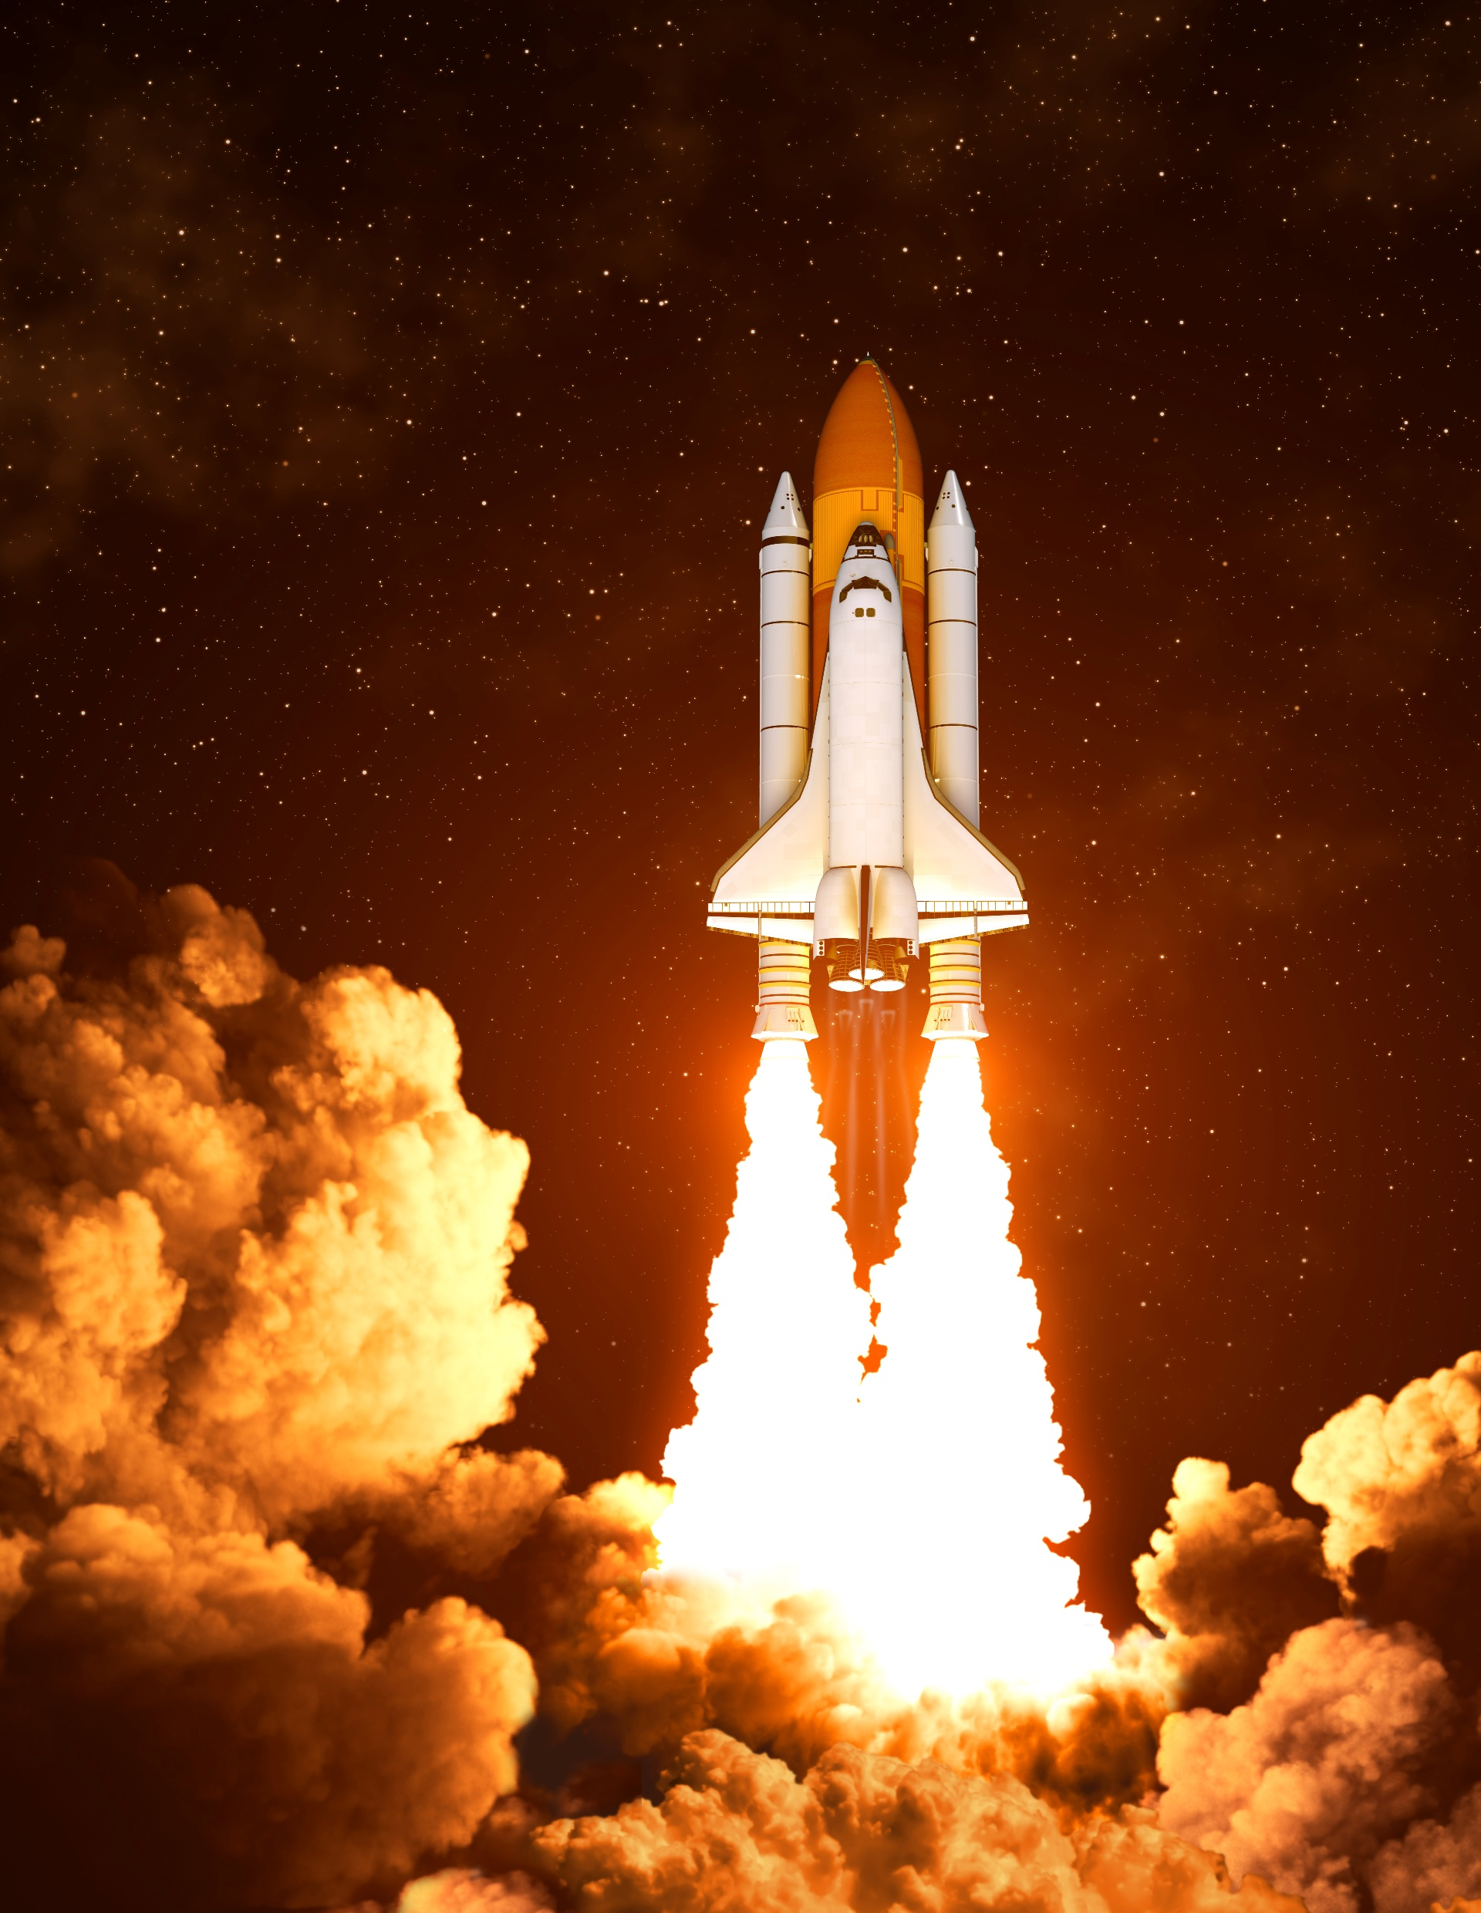



Conclusions
A successful first-stage return significantly reduces rocket launch costs, making reusability a key factor in cost efficiency.
Various factors—including booster type, target orbit, and launch site characteristics—play a significant role in determining the probability of a successful first-stage landing.
Falcon 9 launch facilities are positioned near major highways, railways, and coastal areas to streamline transportation and operational logistics. Additionally, sites with a higher launch frequency tend to exhibit greater success rates.
SpaceX’s launch reliability has shown a steady upward trend since 2013, with the KSC LC-39A facility recording the highest number of successful missions
ES-L1, GEO, HEO, and SSO, orbits have been associated with higher launch success rates, highlighting the importance of orbital positioning in mission planning.

Slide 46


